Slide 1


Modern Operating Systems
Fifth Edition
Chapter 4
File Systems
Copyright © 2023, 2014, 2008 Pearson Education, Inc. All Rights Reserved
Notes:
If this PowerPoint presentation contains mathematical equations, you may need to check that your computer has the following installed:
1) Math Type Plugin
2) Math Player (free versions available)
3) NVDA Reader (free versions available)

Slide 2
File Systems
Think of a disk as a linear sequence of fixed-size blocks and supporting two operations:
Read block k.
Write block k

Slide 3
File Systems
Questions that quickly arise:
How do you find information?
How do you keep one user from reading another user’s data?
How do you know which blocks are free?

Slide 4
File Systems
File Systems are:
A way to organize and (persistently) store information
An abstraction over storage devices:
Hard disk, S S D, network, R A M,
Organized in files and (typically) directories.
Examples:
F A T12/F A T16: M S-D O S
N T F S: Windows
Ext4: Linux
A P F S: mac O S/i O S

Slide 5
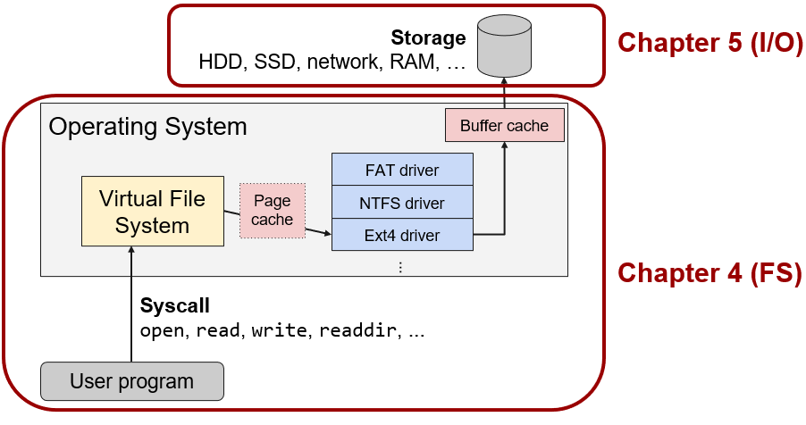
Overview
Notes:
Long Description:
The flow chart labeled from bottom to top is as follows. User program; syscall of open, read, write, readdir, ellipsis; virtual file system; page cache, F A T driver, N T F S driver and E x t 4 driver; buffer cache; storage of H D D, S S D, network, R A M, ellipsis. The virtual file system, page cache, F A T driver, N T F S driver and E x t 4 driver, and buffer cache are part of the operating system. The operating system and the user program are inside a rectangular box with red border and curved edges. The box is further labeled as chapter 4 open parenthesis F S close parenthesis. The storage is also marked inside a rectangular box with red border and curved edges and is labeled as chapter 5 open parenthesis I forward slash O close parenthesis.

Slide 6
Files
Abstract storage nodes
File access:
Sequential versus. random access
File types:
Regular files, directories, soft links
Special files (e.g., device files, metadata files)
File structure:
O S’ perspective: Files as streams of bytes
Program’s perspective: Archives, Executables, etc.

Slide 7
Quiz Question
Q: When does the O S itself care about the contents of a file?
A: Only when the O S uses the file itself (directories, executables, boot image, etc.)

Slide 8
File Naming
Different file systems have different limitations/conventions for file names
File extensions
File name length
characters (later extended to 255)
characters
Special characters in file names
and more
or the special names
and
Case sensitivity

Slide 9
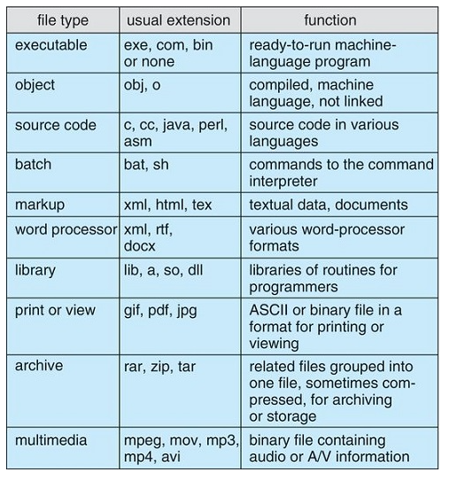
File Types – Name, Extension

Slide 10
File Operations
Create
Delete
O p
Close
Read
Write
Append
Seek
Get attributes
Set attributes
Rename

Slide 11
File Operations
Seeking in files:
int fd = open(“foo.txt”, O_RDONLY);
lseek(fd, 128, SEEK_CUR);
char buf[8];
read(fd, buf, 8);
close(fd);
Move current position in file forwards or backwards.

Slide 12
File Operations
Removing file:
unlink(“foo.txt”);
Renaming file:
rename(“foo.txt”, “bar.txt”);
Change file permission attribute:
c h mod(“foo.txt”, 0755);
Change file owner attribute:
c h o w n(“foo.txt”, u i d, g i d);

Slide 13
Directories
Data structures organizing and maintaining information about files
Often stored as file entries with special attributes
Directories are denoted by “/” (Unix) or “\” (Windows)
Special directory entries:
. Current directory
.. Parent directory

Slide 14
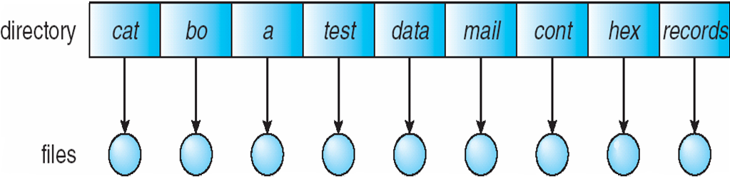
Single-Level Directory
A single directory for all users
Naming problem
Grouping problem

Slide 15
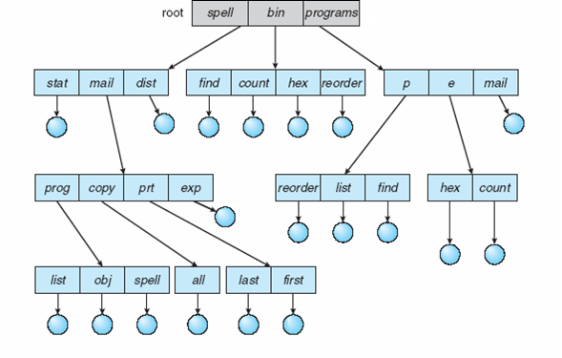
Tree-Structured Directories

Slide 16
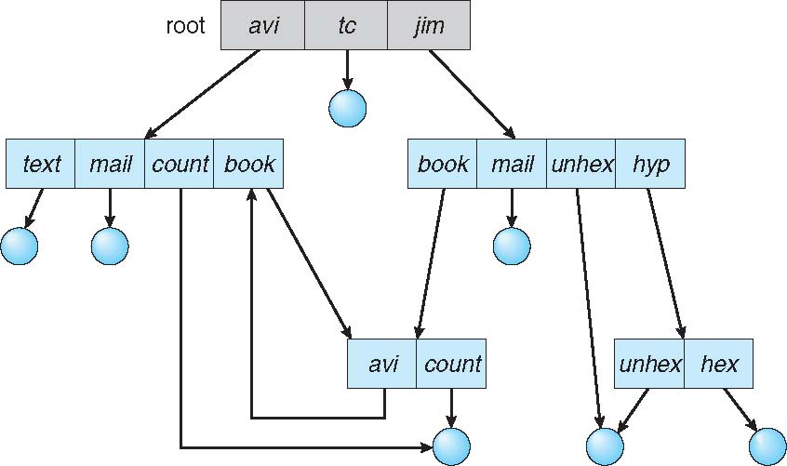
General Graph Directory

Slide 17
Operations Performed on Directory
Search for a file
Create a file
Delete a file
List a directory
Rename a file
Traverse the file system

Slide 18
Protection
File owner/creator should be able to control:
what can be done
by whom
Types of access
Read
Write
Execute
Append
Delete
List

Slide 19
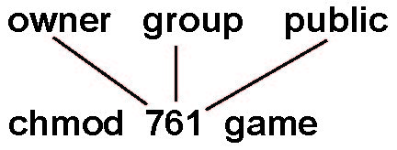
Access Lists and Groups
Mode of access: read, write, execute
Three classes of users on Unix / Linux
RWX
a) owner access 7 ⇒ 1 1 1 RWX
b) group access 6 ⇒ 1 1 0
RWX
c) public access 1 ⇒ 0 0 1
Ask manager to create a group (unique name), say G, and add some users to the group.
For a particular file (say game) or subdirectory, define an appropriate access.
Attach a group to a file chgrp G game

Slide 20
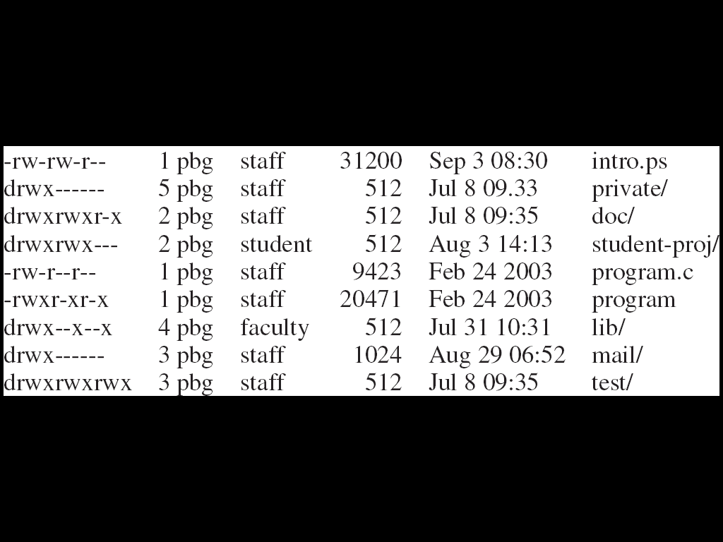
A Sample UNIX Directory Listing

Slide 21
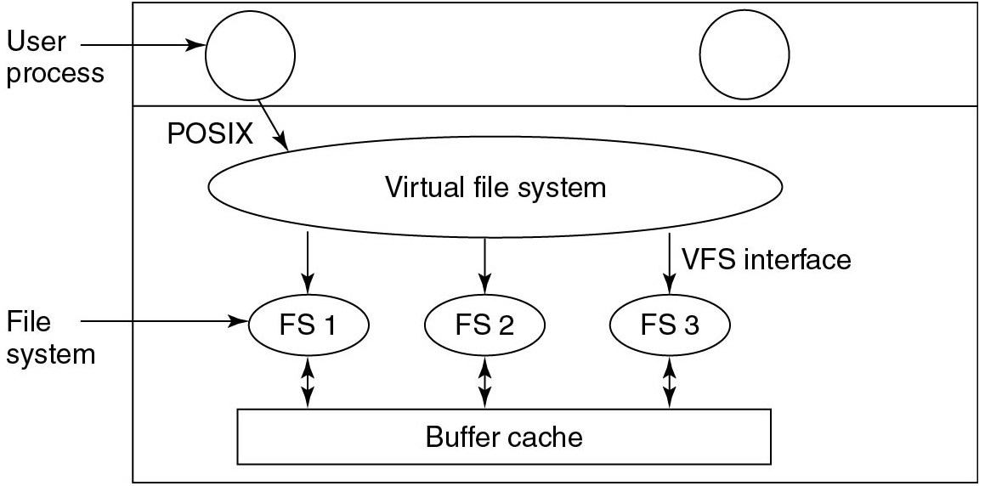
Virtual File Systems
Figure 4.21 Position of the virtual file system.
Notes:
Long Description:
A rectangular block with one horizontal partition. In the first partition, there are two circles labeled User Process. In the second partition, there is a horizontal ellipse labeled Virtual file system. User process points to the virtual file system and is labeled POSIX. A virtual file system with three forward arrows labeled V F S interface points to three small ellipses labeled F S 1, F S 2, and F S 3, and these are labeled File system. From the file system, there are three bidirectional arrows that point to the Buffer Cache block.

Slide 22
File System Implementation
How to store files?
How to implement directories?
How to manage disk space?
How to ensure file system performance?
How to ensure file system dependability?

Slide 23
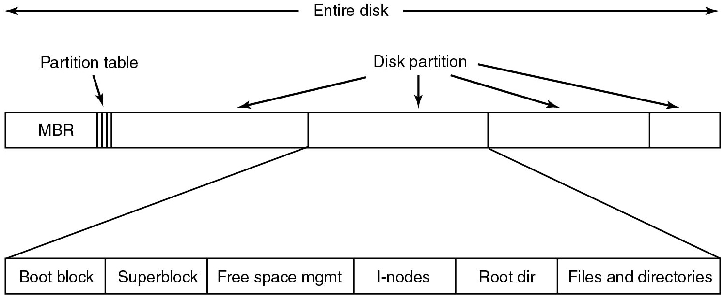
File System Layout
Figure 4.10 A possible file system layout.
Notes:
Long Description:
A horizontal block labeled Entire disk with four partitions labeled Disk partition. The first partition is labeled M B R, there are three vertical lines labeled Partition table in the first partition. The first block points to another horizontal block with six partitions from left to right labeled Boot block, Superblock, Free Space mgmt, I-nodes, Root dir, and Files and directories.

Slide 24
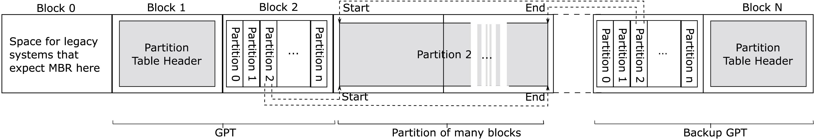
Unified Extensible Firmware Interface (U E F I)
Figure 4.11 Layout for U E F I with partition table
Notes:
Possible layout for U E F I with partition table. Block 0 contains space for legacy systems that expect M B R here. Block 1 contains Partition Table Header. Block 2 contains partitions numbered 0 through n. Partition 2 has a start and end followed by partitions numbered 0 through n.. Block n contains Partition Table Header.
Long Description:
A horizontal block has multiple partitions from Block 0 to Block N. Block 0 is labeled space for legacy systems that expect M B R here. Block 1 has further a square-shaped box inside it and labeled Partition Table Header. Block 2 has further a rectangle-shaped block with multiple partitions from partition 0 to partition n. Block 1 and Block 2 are categorized as G P T. Partition 2 is elaborated and categorized as Partition of many blocks. The partition of many blocks is labeled Start at its upper and lower left ends, and is labeled End at its upper and lower right ends. A dashed line from partition 2 of block 2 partitions points to the Start of Partition of many blocks. A dashed line from partition 2 of block 2 partitions points to the End of Partition of many blocks. Dotted line between this block and the next block depicts the presence of several blocks in between. Block N has further a square-shaped box labeled Partition Table Header inside it. On the left, a box has n partitions labeled Partition 1 to Partition n. A dashed line from Start on the upper left of Partition of many blocks points to the Partition 2 of Block N. A dashed line from End on the upper right of Partition of many blocks points to the Partition 2 of Block N. Block N and the block consisting of n partitions is categorized as Backup G P T.

Slide 25
How to Store Files on the Disk?
Contiguous allocation
Store files as a contiguous stream of bytes
Requires max file size, prone to fragmentation

Slide 26
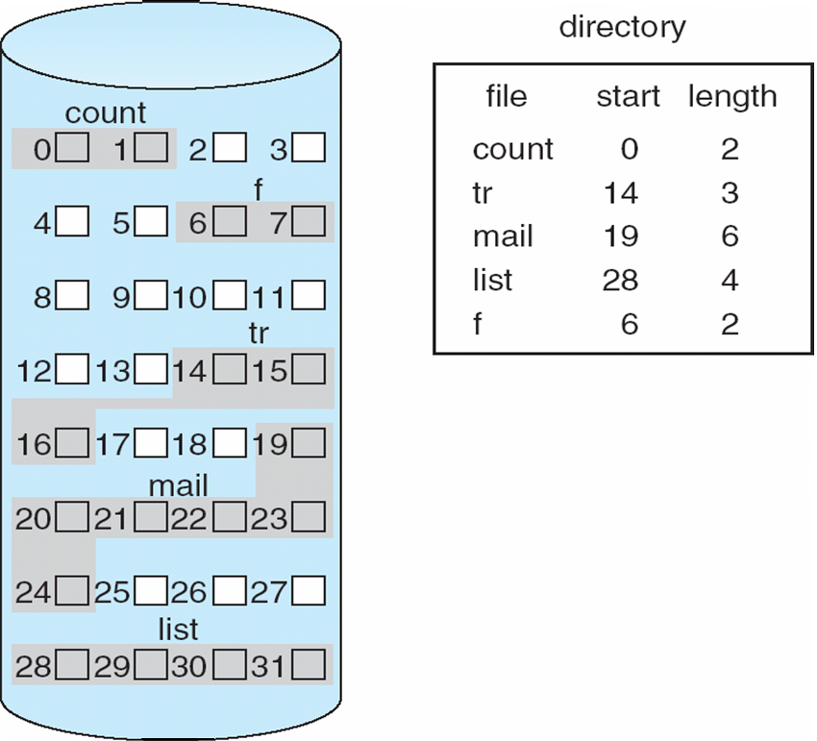
Contiguous Allocation
Mapping from logical to physical
Q
LA/512
R
Block to be accessed = Q + starting address
Displacement into block = R

Slide 27
How to Store Files on the Disk?
Contiguous allocation
Store files as a contiguous stream of bytes
Requires max file size, prone to fragmentation
Block-based strategies
Linked List
File Allocation Table
i-nodes

Slide 28
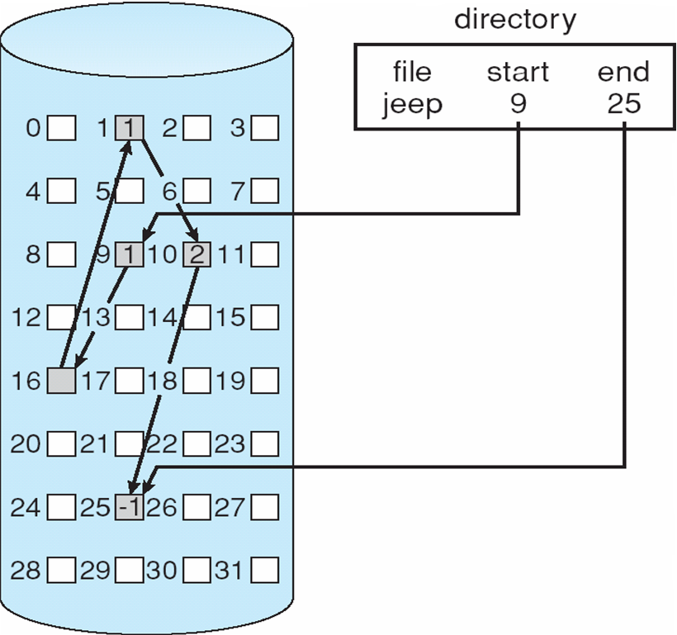
Linked Allocation

Slide 29
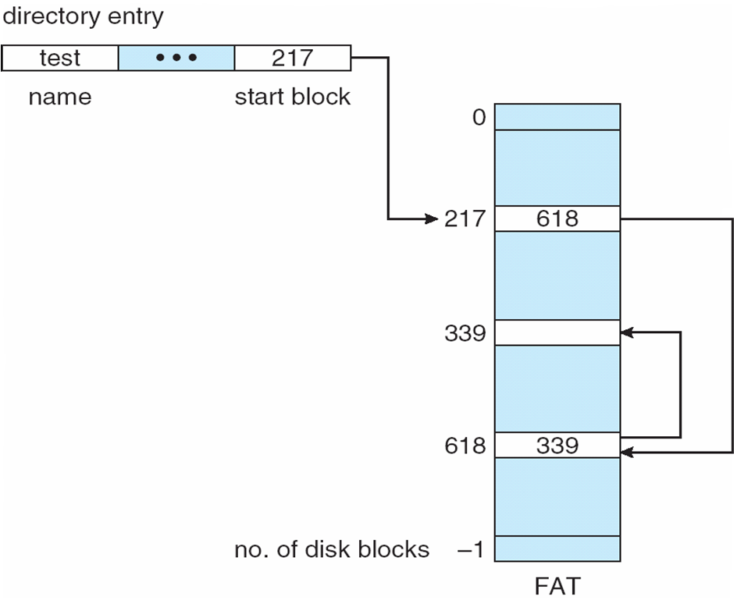
File-Allocation Table

Slide 30
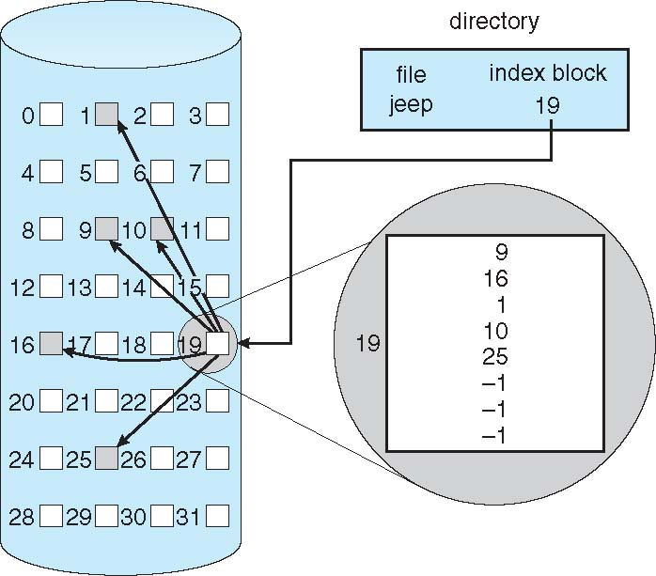
Indexed Allocation

Slide 31
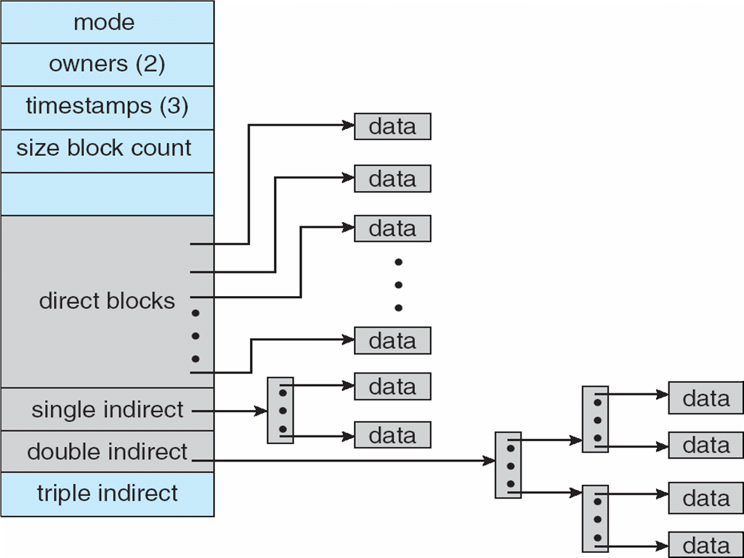
Combined Scheme: UNIX UFS
4K bytes per block, 32-bit addresses
More index blocks than can be addressed with 32-bit file pointer

Slide 32
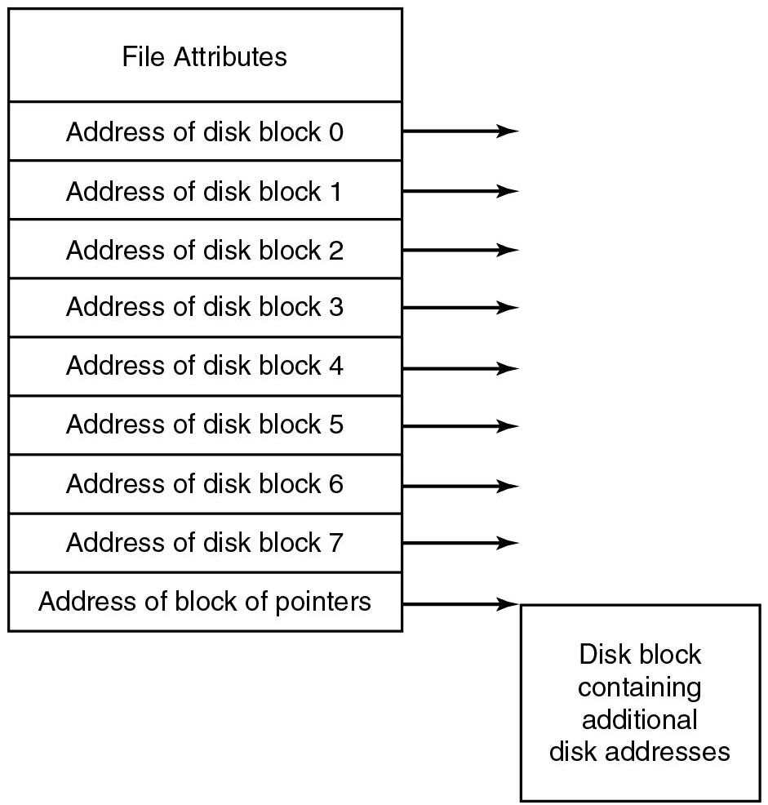
Implementing Files I-nodes
Figure 4.15 An example i-node
Notes:
Long Description:
A vertical block has 10 partitions. An arrow from the right end of all the partitions points to the right. The partitions from top to bottom are as follows: Partition 1 is labeled File Attributes. Partition 2 is labeled Address of disk block 0. Partition 3 is labeled the Address of disk block 1. Partition 4 is labeled the Address of disk block 2. Partition 5 is labeled the Address of disk block 3. Partition 6 is labeled the Address of disk block 4. Partition 7 is labeled the Address of disk block 5. Partition 8 is labeled the Address of disk block 6. Partition 9 is labeled the Address of disk block 7. Partition 10 is labeled the Address of a block of pointers. An arrow from the right end points to a square block labeled Disk block containing additional disk addresses.

Slide 33

F A T 12/F A T 16 Layout
Reserved later used for F S information
F A T #1/#2: preallocated File Allocation Tables
Preallocated root directory
Clusters represent addressable blocks:
F A T contains chains indexed by starting cluster
Notes:
Long Description:
The illustration is divided into 6 slots labeled from left to right. Boot sector, reserved, F A T octothorpe 1, F A T octothorpe 2, root directory and clusters.

Slide 34
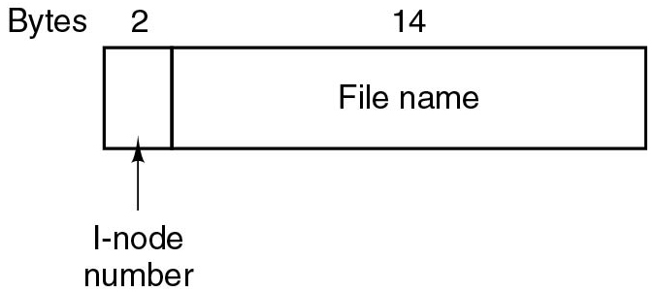
U N I X Directory Entry
Directory entry stores only name and #i-node
Attributes are stored in the i-node
One i-node per file, first i-node is the root
Where are i-nodes stored?
Notes:
Long Description:
A horizontal block has one partition. There are Bytes mentioned above the partitions labeled 2 and 14. The first partition is labeled i-node number and the second partition is labeled File name.

Slide 35
Hard Links versus. Soft Links
Hard links reference a shared file (i-node)
The file is removed only with no hard links left
Space-efficient (only 1 directory entry per hard link)
Good to manage shared files across owners
Soft (or symbolic) links reference a file name
Removing the file renders its soft links invalid
Less space-efficient (need 1 i-node per soft link)
More flexible (can reference file names across F Ses)

Slide 36
Block Size
How do choose the block size?
Important speed-space tradeoff to consider
Larger block sizes allow transferring more data per block
Better overall data rates
Smaller block sizes reduce space overhead for small files
Less fragmentation

Slide 37
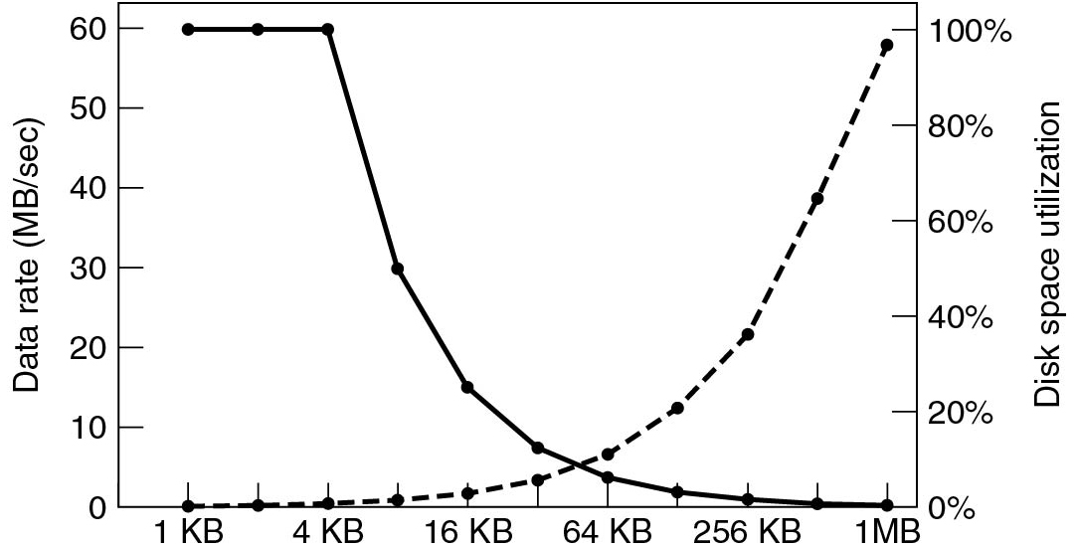
Block Size Impact
Figure 4.23 The dashed curve (left-hand scale) gives the data rate of a disk. The solid curve (right-hand scale) gives the disk space efficiency. All files are 4 K B.
Notes:
Long Description:
The horizontal axis has the following marks: 1 K B, 4 K B, 16 K B, 64 K B, 256 K B, AND 1 M B. The left vertical axis is labeled Data Rate (M B per second) and ranges from 0 to 60 in increments of 10 units. The right vertical axis is labeled Disk space utilization and ranges from 0 percent to 100 percent in increments of 20 units. The first dotted curve starts from (1 K B, 0), moves linearly to the point (12 K B, 0), then raises upward like a concave upward, and increases linearly until the point (1 M B, 60) on the left axis and (1 M B, 100 percent) on the right axis. The curve passes through the following points: (16 K B, 1), (64 K B, 10), and (256 K B, 25). The second curve starts from point (1 K B, 80) moves horizontally until the point (12 K B, 60), then falls as a concave up curve, and ends at the point (1 MB, 0) on the left axis and (1 M B, 0 percent) on the right axis. The curve passes through the following points: (16 K B, 15), (64 K B, 5), and (256 K B, 1).

Slide 38
Free-Space Management
File system maintains free-space list to track available blocks/clusters
(Using term “block” for simplicity)
Bit vector or bit map (n blocks)
0
1
2
n-1
…
1 ⇒ block[i] free
0 ⇒ block[i] occupied
bit[i] =

Block number calculation
(number of bits per word) *
(number of 0-value words) +
offset of first 1 bit
CPUs have instructions to return offset within word of first “1” bit

Slide 39
Free-Space Management (Cont.)
Bit map requires extra space
Example:
block size = 4KB = 2¹² bytes
disk size = 2⁴⁰ bytes (1 terabyte)
n = 2⁴⁰/2¹² = 2²⁸ bits (or 32MB)
if clusters of 4 blocks -> 8MB of memory
Easy to get contiguous files

Slide 40
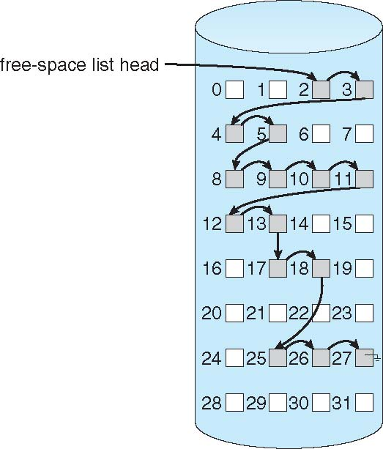
Linked Free Space List on Disk
Linked list (free list)
Cannot get contiguous space easily
No waste of space
No need to traverse the entire list (if # free blocks recorded)

Slide 41
Efficiency and Performance
Efficiency dependent on:
Disk allocation and directory algorithms
Types of data kept in file’s directory entry
Pre-allocation or as-needed allocation of metadata structures
Fixed-size or varying-size data structures

Slide 42
Efficiency and Performance (Cont.)
Performance
Keeping data and metadata close together
Buffer cache – separate section of main memory for frequently used blocks
Synchronous writes sometimes requested by apps or needed by OS
No buffering / caching – writes must hit disk before acknowledgement
Asynchronous writes more common, buffer-able, faster
Free-behind and read-ahead – techniques to optimize sequential access
Reads frequently slower than writes

Slide 43
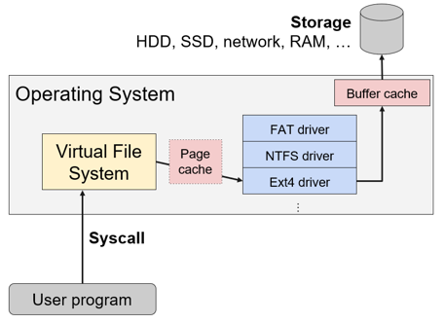
Minimize Disk Access: Caching
Buffer cache: Cache disk blocks in R A M
Page cache: Cache V F S pages (before going to driver)
Often same data as buffer cache, so O S may merge them
Notes:
Long Description:
The flow chart labeled from bottom to top is as follows. User program; syscall of open, read, write, readdir, ellipsis; virtual file system; page cache, F A T driver, N T F S driver and E x t 4 driver; buffer cache; storage of H D D, S S D, network, R A M, ellipsis. The virtual file system, page cache, F A T driver, N T F S driver and E x t 4 driver, and buffer cache are part of the operating system.

Slide 44
Page Cache
A page cache caches pages rather than disk blocks using virtual memory techniques and addresses
Memory-mapped I/O uses a page cache
Routine I/O through the file system uses the buffer (disk) cache
This leads to the following figure

Slide 45
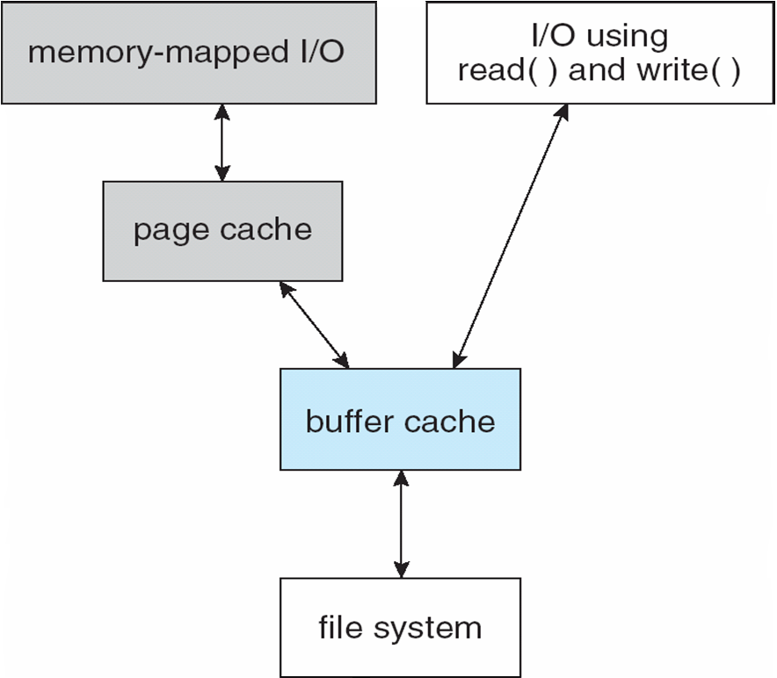
I/O Without a Unified Buffer Cache

Slide 46
Unified Buffer Cache
A unified buffer cache uses the same page cache to cache both memory-mapped pages and ordinary file system I/O to avoid double caching
But which caches get priority, and what replacement algorithms to use?

Slide 47
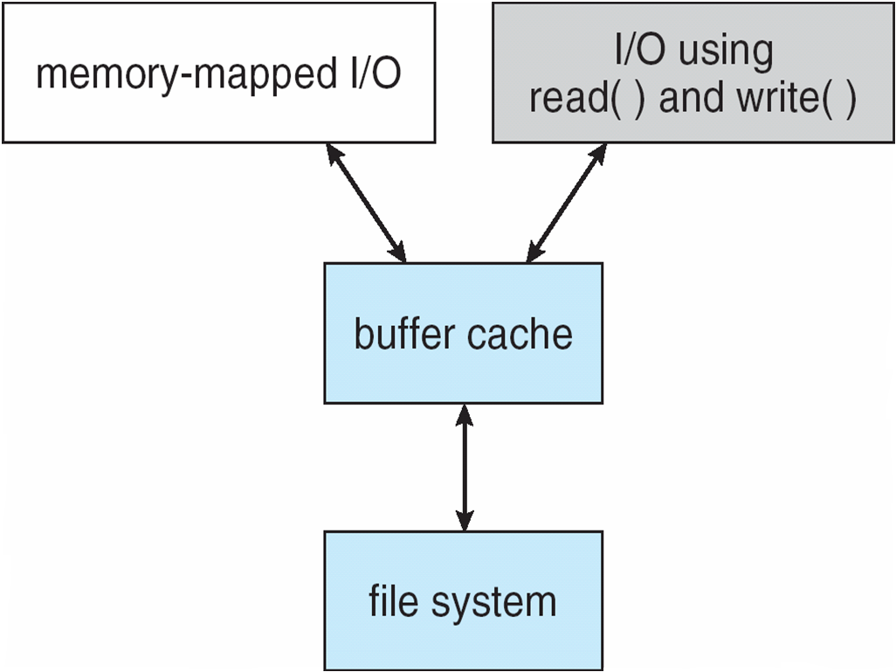
I/O Using a Unified Buffer Cache

Slide 48
Quiz Question
A unified buffer cache ________ .
A) is used for both I/O read() and write() operations in a single cache.
B) is used for both memory-mapped I/O and I/O read() and write() operations in a single cache.
C) is used as both the page cache and buffer cache.
B) is used for both memory-mapped I/O and I/O read() and write() operations in a single cache.

Slide 49
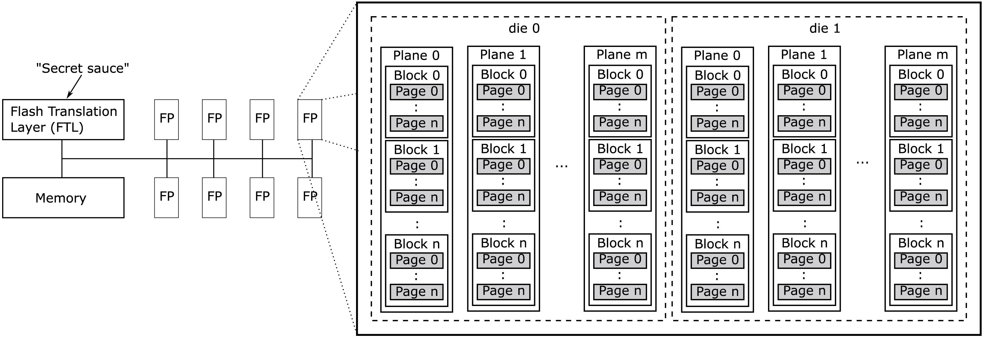
Techniques Used in Flash-Based File Systems
Figure 4.20 Components inside a typical flash S S D.
Notes:
Long Description:
Part (a): The first horizontal block labeled Flash Translation Layer (F T L). An arrow labeled "Secret sauce" on top of the block. This block is connected with a vertical line to a second block labeled Memory placed at bottom of the first block. There are eight blocks labeled F P placed four at the top and parallel to the first block. The other four blocks are placed at the bottom and parallel to the second block. A horizontal line from the vertical line with all eight blocks is connected. Part (b): A large rectangular block has two dotted rectangular blocks labeled die 0 and die 1 inside it. There are m vertical blocks labeled plane 0, plane 1, and up to plane m inside both blocks, arranged side by side. In every vertical block, there are several blocks labeled block 0, block 1, and up to block n corresponding to pages labeled Page 0 to page n in every block.

Slide 50
Quiz Question
Q: Why is yanking out a U S B stick considered “unsafe”?
A: Because there could be ”dirty” blocks in the cache that won’t be written back to the stick, losing their information

Slide 51
File System Dependability Threats
Disk failures:
Bad blocks
Whole-disk errors
Power failures:
(Meta)-data inconsistently written to disk
Software bugs:
Bad (meta)-data written to disk
User errors:
Lost or stolen computer

Slide 52
File System Backups
Backups to disk are generally made to handle one of two potential problems:
Recover from disaster.
Recover from stupidity.

Slide 53
Backups: Properties
Incremental versus. full
Online versus. offline
Physical versus. logical
Compressed versus. uncompressed
Local versus. remote

Slide 54
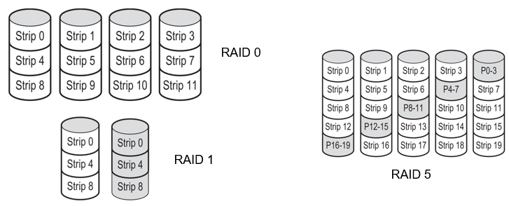
RAID: Redundant Array of Independent Disks
RAID 0 & 2: Expand file system over multiple disks (+storage)
RAID 1: Duplicate file system over disks (+redundancy)
RAID 3-6: Store parity information (+storage, +redundancy)
Notes:
Long Description:
The first illustration labeled as R A I D 0 consists of 4 stacks of 3 cylinders in each. The cylinders in each stack from left to right are labeled as follows. Strip 0, strip 4, strip 8; strip 1, strip 5, strip 9; strip 2, strip 6, strip 10; strip 3, strip 7, strip 11. The second illustration labeled as R A I D 1 consists of 2 stacks of 3 cylinders in each. The cylinders in each stack from left to right are labeled as follows. Strip 0, strip 4, strip 8; strip 0, strip 4, strip 8. The third illustration labeled as R A I D 5 consists of 5 stacks of 5 cylinders in each. The cylinders in each stack from left to right are labeled as follows. Strip 0, strip 4, strip 8, strip 12, strip, P 16 hyphen 19; strip 1, strip 5, strip 9, P 12 hyphen 15, strip 16; strip 2, strip 6, P 8 hyphen 11, strip 13, strip 17; strip 3, P 4 hyphen 7, strip 10, strip 14, strip 18; P 0 hyphen 3, strip 7, strip 11, strip 15, strip 19.

Slide 55
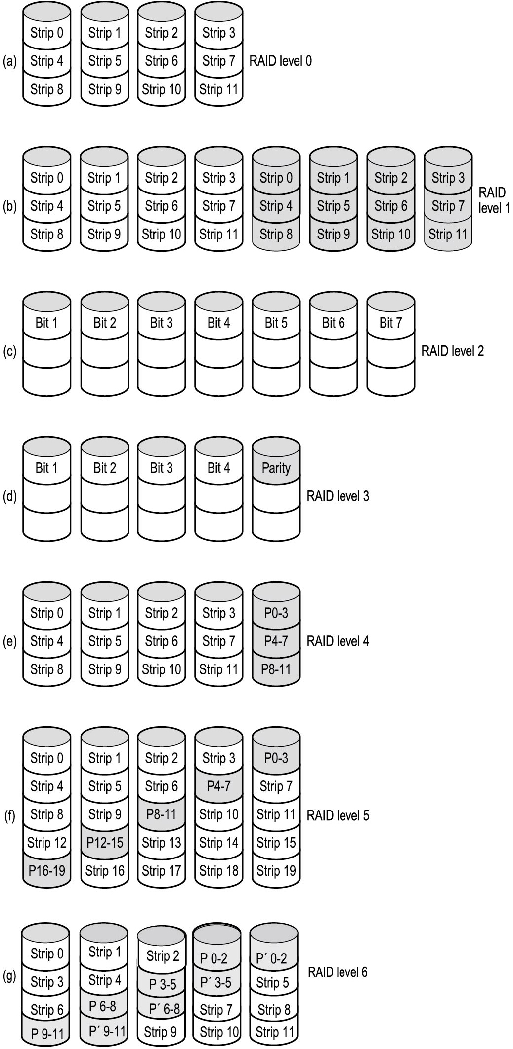
R A I D (1)
Figure 5.26 R A I D levels 0 through 3. Backup and parity drives are shown shaded.
Notes:
Long Description:
Figure a: R A I D level 0: It contains a set of four cylinders which is divided into three sections. The upper sections of each are labeled strip 0, strip 1, strip 2, and strip 3. The middle sections are labeled strip 4, strip 5, strip 6, and strip 7. The lower sections are labeled strip 8, strip 9, strip 10, and strip 11.
Figure b: R A I D level 1: It contains two sets of four cylinders which are divided into three sections. Each set is labeled similarly to the previous figure. The second set of cylinders is shaded.
Figure c: R A I D level 2: It contains a set of seven cylinders which are divided into three sections. The upper sections of each are labeled Bit 1, Bit 2, Bit 3, Bit 4, Bit 5, Bit 6, and Bit 7.
Figure d: R A I D level 3: It contains a set of five cylinders which are divided into three sections. The upper sections of each are labeled Bit 1, Bit 2, Bit 3, Bit 4, Bit 5.

Slide 56
R A I D (2)
Figure 5.26 R A I D levels 4 through 6. Backup and parity drives are shown shaded.
Notes:
Long Description:
Figure e: RAID level 4: It contains a set of five cylinders which are divided into three sections. For the first four cylinders: The upper sections of each cylinder are labeled strip 0, strip 1, strip 2, and strip 3. The middle sections are labeled strip 4, strip 5, strip 6, and strip 7. The lower sections are labeled strip 8, strip 9, strip 10, strip 11.
For the fifth cylinder: The sections are labeled P O 3, P O 7, P 8 to 11 from top to bottom.
Figure f: RAID level 5: It contains a set of five cylinders which are divided into five sections. The sections of each cylinder are labeled in the following way. Section 1: strip 0, strip 1, strip 2, strip 3, P 0 to 3. Section 2: strip 4, strip 5, strip 6, P 4 to 7, strip 7. Section 3: strip 6, strip 9, P 8 to 11, strip 10, strip 11. Section 4: strip 12, P 12 to 15, strip 13, strip 14, strip 15. Section 5: P 16 to 19, strip 16, strip 17, strip 18, strip 19.
Figure g: RAID level 6: It contains a set of five cylinders which are divided into five sections. The sections of each cylinder are labeled in the following way. Section 1: strip 0, strip 1, strip 2, P 0 to 2, P prime 0 to 2. Section 2: strip 3, strip 4, P 3 to 5, P prime 3 to 5. Section 3: strip 6, P 6 to 8, P prime 6 to 8, strip 7, strip 8. Section 4: strip 12, P 12 to 15, strip 13, strip 14, strip 15. Section 5: P 9 to 11, P prime 9 to 11, strip 9, strip 10, strip 11.

Slide 57
Quiz Question
Does RAID help with the following threats:
Physical failure (disk stops working)?
Computer catching fire or getting stolen?
Power failure (inconsistent write)?
Bug in driver?
User error?
Yes
No
Yes
Maybe, depends on the bug
No

Slide 58
Modern Operating Systems
Fifth Edition
Chapter 4- End
File Systems
Copyright © 2023, 2014, 2008 Pearson Education, Inc. All Rights Reserved
Notes:
If this PowerPoint presentation contains mathematical equations, you may need to check that your computer has the following installed:
1) Math Type Plugin
2) Math Player (free versions available)
3) NVDA Reader (free versions available)

